Slide 1

The Linux Kernel: Introduction

Slide 2
Kernel Design Goals
Performance: efficiency, speed.
Utilize resources to capacity with low overhead.
Stability: robustness, resilience.
Uptime, graceful degradation.
Capability: features, flexibility, compatibility.
Security, protection.
Protect users from each other & system from bad users.
Portability.
Extensibility.

Slide 3
Example “Core” Kernel
Applications
System Libraries (libc)
System Call Interface
I/O Related
Process Related
Modules
File Systems
Scheduler
Networking
Memory Management
Device Drivers
IPC
Architecture-Dependent Code
Hardware
Notes:
Stephen Tweedie claims “All kernel code executes in a process context (except during startup)”. He also says that it is possible for an interrupt to occur during a context switch.
So it is uncommon for there to be no user process mapped. The real problem is not knowing what process is mapped. Kernel mode, system context activities occurs asynchronously and may be entirely unrelated to the current process.

Slide 4
Architectural Approaches
Monolithic.
Layered.
Modularized.
Micro-kernel.
Virtual machine.

Slide 5
Linux Source Tree Layout
Documentation
/usr/src/linux
scripts
init
ipc
kernel
net
arch
drivers
fs
lib
mm
include
acorn
atm
block
cdrom
char
dio
fc4
i2c
i2o
ide
ieee1394
isdn
macintosh
misc
net
…
802
appletalk
atm
ax25
bridge
core
decnet
econet
ethernet
ipv4
ipv6
ipx
irda
khttpd
lapb
…
adfs
affs
autofs
autofs4
bfs
code
cramfs
devfs
devpts
efs
ext2
fat
hfs
hpfs
…
asm-alpha
asm-arm
asm-generic
asm-i386
asm-ia64
asm-m68k
asm-mips
asm-mips64
linux
math-emu
net
pcmcia
scsi
video …
adfs
affs
autofs
autofs4
bfs
code
cramfs
devfs
devpts
efs
ext2
fat
hfs
hpfs …
alpha
arm
i386
ia64
m68k
mips
mips64
ppc
s390
sh
sparc
sparc64

Slide 6
linux/arch
Subdirectories for each current port.
Each contains kernel, lib, mm, boot and other directories whose contents override code stubs in architecture independent code.
lib contains highly-optimized common utility routines such as memcpy, checksums, etc.
arch as of 2.4:
alpha, arm, i386, ia64, m68k, mips, mips64.
ppc, s390, sh, sparc, sparc64.

Slide 7
linux/drivers
Largest amount of code in the kernel tree (~1.5M).
device, bus, platform and general directories.
drivers/char – n_tty.c is the default line discipline.
drivers/block – elevator.c, genhd.c, linear.c, ll_rw_blk.c, raidN.c.
drivers/net –specific drivers and general routines Space.c and net_init.c.
drivers/scsi – scsi_*.c files are generic; sd.c (disk), sr.c (CD-ROM), st.c (tape), sg.c (generic).
General:
cdrom, ide, isdn, parport, pcmcia, pnp, sound, telephony, video.
Buses – fc4, i2c, nubus, pci, sbus, tc, usb.
Platforms – acorn, macintosh, s390, sgi.

Slide 8
linux/fs
Contains:
virtual filesystem (VFS) framework.
subdirectories for actual filesystems.
vfs-related files:
exec.c, binfmt_*.c - files for mapping new process images.
devices.c, blk_dev.c – device registration, block device support.
super.c, filesystems.c.
inode.c, dcache.c, namei.c, buffer.c, file_table.c.
open.c, read_write.c, select.c, pipe.c, fifo.c.
fcntl.c, ioctl.c, locks.c, dquot.c, stat.c.

Slide 9
linux/include
include/asm-*:
Architecture-dependent include subdirectories.
include/linux:
Header info needed both by the kernel and user apps.
Usually linked to /usr/include/linux.
Kernel-only portions guarded by #ifdefs
#ifdef __KERNEL__
/* kernel stuff */
#endif
Other directories:
math-emu, net, pcmcia, scsi, video.

Slide 10
linux/init
Just two files: version.c, main.c.
version.c – contains the version banner that prints at boot.
main.c – architecture-independent boot code.
start_kernel is the primary entry point.

Slide 11
linux/ipc
System V IPC facilities.
If disabled at compile-time, util.c exports stubs that simply return –ENOSYS.
One file for each facility:
sem.c – semaphores.
shm.c – shared memory.
msg.c – message queues.

Slide 12
linux/kernel
The core kernel code.
sched.c – “the main kernel file”:
scheduler, wait queues, timers, alarms, task queues.
Process control:
fork.c, exec.c, signal.c, exit.c etc…
Kernel module support:
kmod.c, ksyms.c, module.c.
Other operations:
time.c, resource.c, dma.c, softirq.c, itimer.c.
printk.c, info.c, panic.c, sysctl.c, sys.c.

Slide 13
linux/lib
kernel code cannot call standard C library routines.
Files:
brlock.c – “Big Reader” spinlocks.
cmdline.c – kernel command line parsing routines.
errno.c – global definition of errno.
inflate.c – “gunzip” part of gzip.c used during boot.
string.c – portable string code.
Usually replaced by optimized, architecture-dependent routines.
vsprintf.c – libc replacement.

Slide 14
linux/mm
Paging and swapping:
swap.c, swapfile.c (paging devices), swap_state.c (cache).
vmscan.c – paging policies, kswapd.
page_io.c – low-level page transfer.
Allocation and deallocation:
slab.c – slab allocator.
page_alloc.c – page-based allocator.
vmalloc.c – kernel virtual-memory allocator.
Memory mapping:
memory.c – paging, fault-handling, page table code.
filemap.c – file mapping.
mmap.c, mremap.c, mlock.c, mprotect.c.

Slide 15
linux/scripts
Scripts for:
Menu-based kernel configuration.
Kernel patching.
Generating kernel documentation.

Slide 16
Summary
Linux is a modular, UNIX-like monolithic kernel.
Kernel is the heart of the OS that executes with special hardware permission (kernel mode).
“Core kernel” provides framework, data structures, support for drivers, modules, subsystems.
Architecture dependent source sub-trees live in /arch.
Notes:
BOOKS
Maxwell Chapter 4: System Initialization
Rubini Chapter 16 pages 362-369
Beck 3.2.3
GUIDES
Linux System Administrator’s Guide
HOWTOs
Bootdisk-HOWTO
BootPrompt-HOWTO
Diskless-HOWTO
Diskless-root-NFS-HOWTO
KERNEL DOC
Documentation/initrd.txt
Documentation/ramdisk.txt
APPLICATION DOC
LILO: User’s Guide
LILO: Technical Overview
OTHER
UltraLinux FAQ: Section 6 Booting
Intel Architecture Software Developer’s Manual Volume 3: System Programming
SA-110 Microprocessor Technical Reference Manual
GNU GRUB
Multiboot Standard
OpenPROM
Solaris “man boot”

Slide 17
The Bootloader

Slide 18
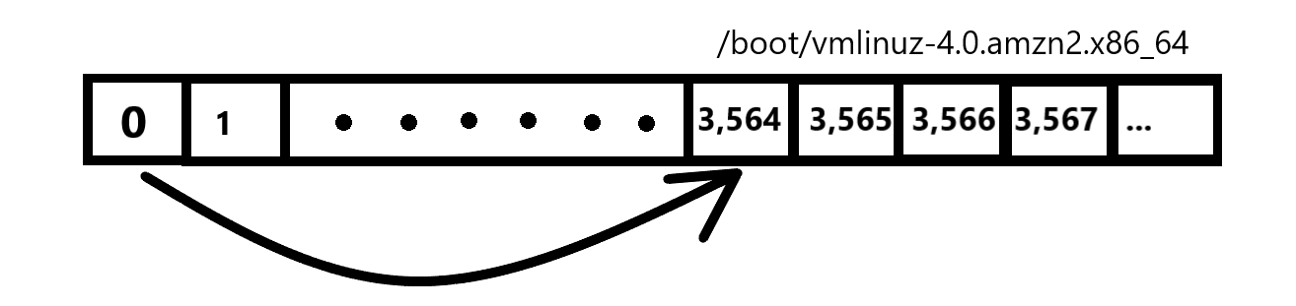
The Bootloader
Responsible for loading the operating system into memory.
LILO (Linux Loader) was the default for a long time
It works by pointing to the first sector where the kernel is stored (simplified).
Has limited functionality due to the 446 bytes available in MBR

Slide 19
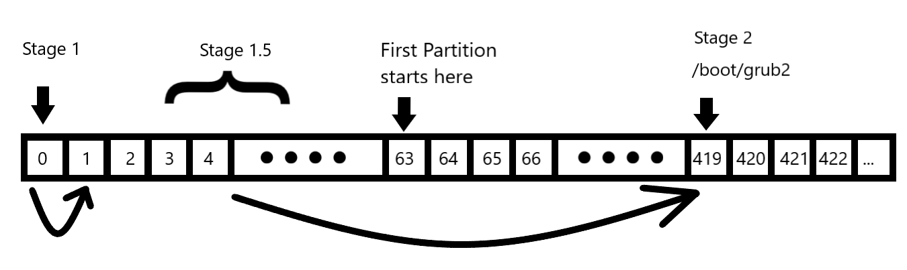
The Bootloader - GRUB
GRUB replaced LILO as the default Linux bootloader (we’ll focus on version 2 but version 1 is similar).
Split into 3 stages.

Slide 20
The Bootloader - GRUB
Stage 1 loads Stage 1.5
Stage 1.5 loads the grub kernel and filesystem modules needed to locate Stage 2 ( /boot/grub2 )
Stage 2 parses /boot/grub2/grub.cfg and displays GRUB Menu
When a (Linux) OS is selected, corresponding kernel image along with the appropriate initramfs images are loaded into memory.
If Windows is selected, GRUB chainloads the Windows Bootloader.

Slide 21
The Chicken-and-Egg problem

Slide 22
The Chicken-and-Egg Problem
The kernel needs to mount the root filesystem which can have one or more properties:
NFS
RAID
LVM
Encryption
The necessary modules are stored in /lib/modules
In order to access them, the filesystem must be mounted.

Slide 23
The Chicken-and-Egg Problem
Solution?

Slide 24
Initial Ram Disk (initrd)
A temporary filesystem that has all the stuff needed to mount the root filesystem.
Initial Ram Disk (initrd) is an image of a block device.
Grub makes it available as a special block device in memory (/dev/ram)
The kernel mounts this device and uses it as it’s root filesystem.
Kernel must be compiled with the drivers needed to mount initrd.

Slide 25
Initrd vs Initramfs

Slide 26
initrd vs initramfs
Initrd is made available as a block device that is mounted in memory.
Initramfs is an archive that contains the directory structure of a typical filesystem.
Archive is extracted to created a tmpfs (temporary filesystem)
Mounted in memory to create initramfs
Initramfs introduced in Linux Kernel v2.6.13

Slide 27
The Kernel

Slide 28
The Kernel
Initializes and configures memory and various hardware.
Extract initramfs into a tempfs and mount it in memory
Mount the root filesystem as read-only.
Start the first program.

Slide 29
SysV Init

Slide 30
SysV-Init
The first program started by the kernel, thus has a PID of 1.
A daemon that runs throughout the lifetime of the system until it shuts down. Manages all other daemons and programs.
Program is located at “/sbin/init”

Slide 31
The rc.sysinit script
Located at “/etc/rc.d/rc.sysinit”, this is the first script that is executed by init and it will perform the following tasks:
Set the system’s hostname
Unmount initramfs
Sets kernel parameters as defined in /etc/sysctl.conf.
Start devfs
Mount procfs and sysfs
Dumps the current contents of the kernel ring buffer into /var/log/dmesg
Process /etc/fstab (mounting and running fsck)
Enable RAID and LVM
After the rc.sysinit script is executed, the relevant runlevel scripts are executed.

Slide 32
Runlevels
A runlevel describes the state of a system with regards to the services and functionality that is available.
There are a total of 7 runlevels which are defined as follows:
0: Halt or shutdown the system
1: Single user mode
2: Multi-user mode, without networking
3: Full multi user mode, with networking
4: Officially not defined; Unused
5: Full multi user with NFS and graphics (typical for desktops)
6: Reboot
Default runlevel is configured in the config file /etc/inittab
Notes:
Discuss use cases of the different runlevels.
Runlevel 3 – cloud environment where you only have access to the terminal.
Runlevel 5 – GUI environment.
You can troll someone by changing the default runlevel to 0, 1 or 6.

Slide 33
Runlevel Scripts
Runlevel scripts are responsible for starting and stopping services that will provide the functionality for the respective runlevel.
Located under “/etc/rc.d”:
$ ls -l /etc/rc.d total 60 drwxr-xr-x 2 root root 4096 Aug 26 09:19 init.d -rwxr-xr-x 1 root root 2617 Aug 17 2017 rc drwxr-xr-x 2 root root 4096 Aug 26 09:19 rc0.d drwxr-xr-x 2 root root 4096 Aug 26 09:19 rc1.d drwxr-xr-x 2 root root 4096 Aug 26 09:19 rc2.d drwxr-xr-x 2 root root 4096 Aug 26 09:19 rc3.d drwxr-xr-x 2 root root 4096 Aug 26 09:19 rc4.d drwxr-xr-x 2 root root 4096 Aug 26 09:19 rc5.d drwxr-xr-x 2 root root 4096 Aug 26 09:19 rc6.d -rwxr-xr-x 1 root root 220 Jul 2 06:56 rc.local -rwxr-xr-x 1 root root 20108 Aug 17 2017 rc.sysinit

Slide 34
Runlevel Scripts
Naming convention of the scripts is as follows:
Starts with “S” or “K”. “S” scripts are used to start the service and “K” scripts are used to stop the service.
Followed by a number that specifies the order in which the scripts are to be executed.
Ends with the name of the service.
Notes:
For example, you will notice that the “network” Start script is set to start before the “ssh” service script since a system will need to have network access before the SSH service can start. Consequently, the network Kill script is set to execute AFTER the ssh service Kill script.

Slide 35
rc.local sript
After the runlevel scripts have been executed, the last script to run is the /etc/rc.d/rc.local script.
You can add custom Bash commands you want to be executed at boot.
The login prompt will show up after the rc.local script has been executed.

Slide 36
SysV-Init Important Commands
$ service httpd start
$ service httpd status
$ chkconfig httpd on
$ runlevel
$ telinit 3
$ sed -i “s/^id:.*:initdefault:/id:3:initdefault/” /etc/inittab

Slide 37
SystemD Boot Process

Slide 38
SystemD
SystemD is a system and service manager that was designed to replace SysV-Init which has the following limitations:
Services are started sequentially.
Longer boot times.
No easy and straightforward way to monitor running services.
Dependencies have to be handled manually.
Notes:
- Services are started sequentially even services that do not depend on each other.
- Longer boot times (most because of the point mentioned above)
- No easy and straightforward way to monitor running services.
- Dependencies have to be handled manually so you need very good knowledge of the dependencies involved when you want to modify the runlevel scripts to add a new service.

Slide 39
SystemD Units
Every resource that is managed by SystemD is called a unit.
A unit is a plain-text file that stores information about any one of the following:
a service
a socket
a device
a mount point,
an automount point
a swap file or partition
a start-up target
a watched file system path
a timer controlled and supervised by systemd
a resource management slice or a group of externally created processes.

Slide 40
SystemD Target Units
Runlevels were replaced by “target” units,
Target files are used to group together units that are needed for that specific target (services, sockets, devices, etc.)
SysV-Init Runlevel | SystemD Start-up Target
0: Halt or shutdown the system | poweroff.target
1: Single User mode | rescue.target
2: Multi-user mode, without networking | multi-user.target
3: Full multi user mode, with Networking | multi-user.target
4: Undefined | multi-user.target
5: Full multi-user mode with networking and graphical desktop. | graphical.target
6: Reboot | reboot.target

Slide 41
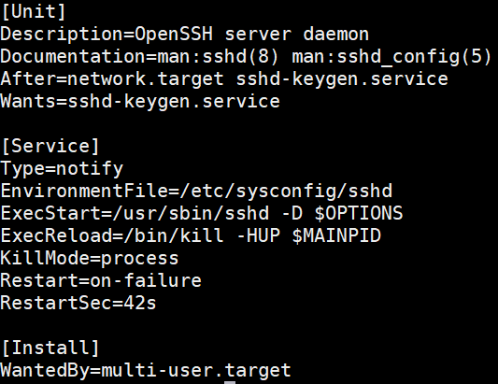
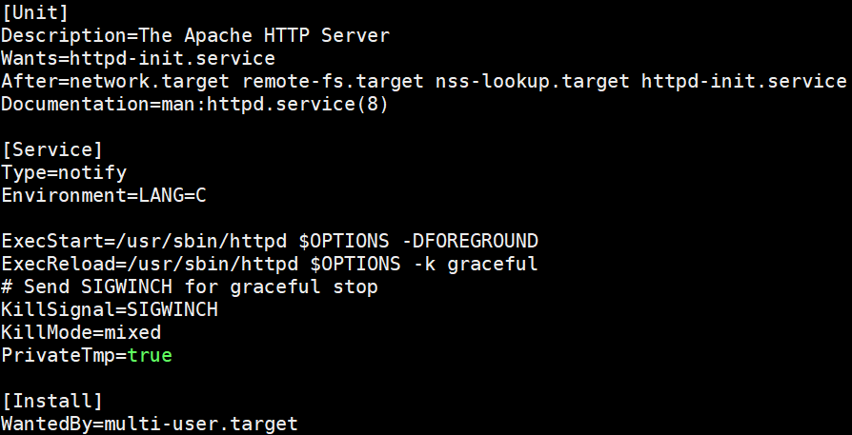
SystemD Service Units
Runlevel Scripts were replaced by systemd unit files (mostly service unit files)
A service unit file will define how that service is started and stopped.

Slide 42
SystemD Dependencies
There are 3 main ways of defining the dependencies of unit (target or service):
“Wants=” statements inside the unit files.
“Requires=” statements inside the unit files.
Special “.wants” directories associated with each target unit file found under the directory /etc/systemd/system
When you enable a service using systemctl, systemd creates a symbolic link in the default target’s “.wants” directory that points to the service unit file.

Slide 43
SystemD Boot Process
When a system boots into a specific target, all the dependent units are activated (services, mounts, sockets, etc.)
All the tasks that are performed by the rc.sysinit script are replaced by “sysinit.target”.
basic.target, multi-user.target, graphical.target and rescue.target all have sysinit.target as one of their dependencies.
By default, rc.local script will not run by default unless if you make it executable:
chmod +x /etc/rc.d/rc.local

Slide 44
Booting and Kernel Initialization

Slide 45
System Lifecycle: Ups & Downs
LILO
start_kernel
sleep? (hlt)
shutdown
init
Power on
Power off
Boot
Kernel Init
OS
Init
RUN!
Shut down
Notes:
Much of this chapter is devoted to details of booting which can be quite complex. Reviewing the details helps to dispel some of the mystery surrounding the process and provides an appreciation for the complex hardware, firmware, software coordination required.
We spend time looking at the standard Intel boot manager LILO as well as introducing the Skiff bootloader.
Kernel initialization is staged. Low-level, device-dependent initialization finally yields to high-level, device-independent initialization. Each category has initialization dependencies. Certain things must be done before other things.Each logical Linux subsystem has one or more _init() functions that are called during this process.
Processes 0 and 1 are discussed. Process 1 (init) is responsible for all user-level process creation.
Shutdown is also staged but not as complex as startup. /sbin/shutdown and init cooperate to bring the system down gently.
Linux enthusiasts continue to stretch the bounds. We review some creative thinking about the boot process.
Power management is an increasingly important OS responsibility and part of the system lifecycle.

Slide 46

Boot Terminology
Loader:
Program that moves bits from disk (usually)
to memory and then transfers CPU control to the newly
“loaded” bits (executable).
Bootloader / Bootstrap:
Program that loads the “first program” (the kernel).
Boot PROM / PROM Monitor / BIOS:
Persistent code that is “already loaded” on power-up.
Boot Manager:
Program that lets you choose the “first program” to load.
Notes:
Loading is an important and often over-looked OS concept. Loading is increasingly accomplished “on-demand” via dynamic linking-loaders. The Linux kernel module mechanism is essentially an advanced application of dynamic linking/loading.
People often mistakenly think that “bootstrap” refers to boot laces.
The “bootstrap” metaphor refers to the nonsensical image of someone lifting themselves up off the ground by their own bootstrap. The impossibility of this image adds to the mystery of the boot process.
There are lots of related types of “firmware”: ROM, PROM, EPROM, EEPROM, NVRAM, Flash RAM and who knows what else. PROM in “Boot PROM” or “PROM Monitor” is used informally. In the SPARC architecture, these are actually contained in EEPROMs.
The phrase “first program” is in quotes for a reason. Often the first program loaded is itself a boot manager, like LILO.
LILO introduces the concept of “chain loaders”. Why not have one loader load another loader which might load another loader…

Slide 47

LILO: LInux LOader
A versatile boot manager that supports:
Choice of Linux kernels.
Boot time kernel parameters.
Booting non-Linux kernels.
A variety of configurations.
Characteristics:
Lives in MBR or partition boot sector.
Has no knowledge of filesystem structure so…
Builds a sector “map file” (block map) to find kernel.
/sbin/lilo – “map installer”.
/etc/lilo.conf is lilo configuration file.
Notes:
LILO was developed by Almesberger as a way of adding flexibility to the boot process, primarily as a means for Linux to co-exist with DOS. There are literally dozens of boot “scenarios” that are possible with LILO..
LILO is the Intel boot manager. Different architectures have variants. MILO for Dec Alpha systems and SILO for SPARC systems are two notable family members. PowerPC platforms use BOOTX and YABOOT. Other, less popular, Intel boot loaders include: LOADLIN, BOOTLIN, SYSLINUX, etc.
LILO comes with an extensive User’s Guide and a succinct but valuable Technical Overview. Both of these are available in the LILO distribution tarball.
A key issue with boot loaders is whether they have knowledge of the filesystem structure. LILO does not and this explains the need for a “block map” and running the “map installer”. Adding knowledge of filesystem structure simplifies booting but significantly increases the size and complexity of the bootloader. In effect, it contains a minimal (“stand-alone”) filesystem implementation. Solaris OpenBoot uses secondary bootloaders that understand a filesystem (ufsboot, nfsboot).
/sbin/lilo must ask the kernel to identify the disk blocks containing the kernel to load as well as other configuration and data blocks. LILO uses these low-level SHC (sector/head/cylinder) addresses to find relevant sectors without needing to “decode” the filesystem structure

Slide 48
Example lilo.conf File
boot=/dev/hda
map=/boot/map
install=/boot/boot.b
prompt
timeout=50
default=linux
image=/boot/vmlinuz-2.2.12-20
label=linux
initrd=/boot/initrd-2.2.12-20.img
read-only
root=/dev/hda1
Notes:
Begin by loading the boot sector (MBR) of the primary IDE hard disk /dev/hda.
Store the block map in the standard place.
Use the standard primary and secondary boot loaders.
Allow the user to enter commands at “LILO boot:”
Only give them 5 seconds though!
Boot the kernel labeled “linux” by default if no user input is provided.
The remaining sections detail available boot images. Characteristics are indented following the image= line.
Let users identify the the image using this tag. (Press TAB at the LILO prompt for a list of available images.)
Load the identified “initial ramdisk” (described later).
Mount root read-only during boot. This is safer and allows an initial fsck.
Use the first partition of the primary IDE disk as the root filesystem.

Slide 49
/sbin/init
Ancestor of all processes (except idle/swapper process).
Controls transitions between “runlevels”:
0: shutdown
1: single-user
2: multi-user (no NFS)
3: full multi-user
5: X11
6: reboot
Executes startup/shutdown scripts for each runlevel.
Notes:
There is a lot that can be said about /sbin/init but this is not a system administration class so we will just mention a few things.
/sbin/init “stages” startup and shutdown in two ways. First via the concept of runlevels. Second, within a runlevel specific startup (S) and shutdown (K- kill) scripts are run in priority order.
This init structure is a System V derivative that is increasingly popular in the Linux world for its flexibility.
A normal Linux system executes at runlevel 5.
Single-user mode is a simple administrative mode that allows a system administrator to correct problems and update configurations without interference from other users.
Linux allows processes to provide a return code for their parent (wait). So process context must remain in the kernel until the parent “joins” the child. Orphan processes resulting from early parent death are “inherited” by init.
The telinit command communicates with init by sending signals to change the run level. The linuxconf command provides a fancy graphical interface to init and helps visualize the activities of the various runlevels.

Slide 50

Shutdown
Use /bin/shutdown to avoid data loss and filesystem corruption.
Shutdown inhibits login, asks init to send SIGTERM to all processes, then SIGKILL.
Low-level commands: halt, reboot, poweroff.
Use -h, -r or -p options to shutdown instead.
Ctrl-Alt-Delete “Vulcan neck pinch”:
defined by a line in /etc/inittab.
ca::ctrlaltdel:/sbin/shutdown -t3 -r now.
Notes:
Buffered writes are not the only reason why “pulling the plug” is a bad way to shut down a Linux system. “Graceful termination” is important for all sorts of “transaction oriented” activities.
Buffered writes are “flushed” via the “sync” command. Old UNIX lore has it that a system admin should type sync three times in rapid succession and then pray before shutdown.
Actually the non-deterministic nature of disk access makes it impossible to *guarantee* that all writes have been flushed but it works almost all the time.
The kernel demon responsible for periodically flushing write buffers is bdflush. It interacts with a user space demon that is controlled by /sbin/update.
The low-level halt and reboot commands are now smarter than they used to be. If you are not in runlevel 0 or 6, they will call shutdown for you to keep your from coming to harm.

Slide 51

Advanced Boot Concepts
Initial ramdisk (initrd) – two-stage boot for flexibility:
First mount “initial” ramdisk as root.
Execute linuxrc to perform additional setup, configuration.
Finally mount “real” root and continue.
See Documentation/initrd.txt for details.
Also see “man initrd”.
Net booting:
Remote root (Diskless-root-HOWTO).
Diskless boot (Diskless-HOWTO).
Notes:
initrd is an interesting example of a mechanism that has a lot of potential uses. Good OS development is about the development of general useful mechanisms that perform well.
/linuxrc can be used to detect devices and load appropriate drivers, allowing “custom” kernels to be built for specific machines while maintaining a uniform “base” install. This is very attractive for administering large installations with diverse platforms.
The two-stage “custom boot” process also addresses “kernel bloat”, a big concern of the kernel developers. Why load all sorts of modules and drivers that are not necessary?
Diskless workstations have been around for a long time and “net booting” is an interesting process. It requires boot loaders with networking smarts. Solaris OpenBoot supports netbooting in the PROM monitor. It loads the primary boot loader using TFTP (trivial FTP). Most of the net-based workstation configuration used today like DHCP was originally developed to support diskless workstation boot.
“Diskless” is something of a misnomer. Diskfull workstations often boot cleanly over the net and use the local disk only for swapping and cache. I’ve heard of one system that reformats the local disk for security at boot!
The two prominent netboot packages are NetBoot and EtherBoot. Both require special firmware support for normal operation.

Slide 52
Summary
Bootstrapping a system is a complex, device-dependent process that involves transition from hardware, to firmware, to software.
Booting within the constraints of the Intel architecture is especially complex and usually involves firmware support (BIOS) and a boot manager (LILO).
/sbin/lilo is a “map installer” that reads configuration information and writes a boot sector and block map files used during boot.
start_kernel is Linux “main” and sets up process context before spawning process 0 (idle) and process 1 (init).
The init() function performs high-level initialization before exec’ing the user-level init process.
Notes:
BOOKS
Maxwell Chapter 4: System Initialization
Rubini Chapter 16 pages 362-369
Beck 3.2.3
GUIDES
Linux System Administrator’s Guide
HOWTOs
Bootdisk-HOWTO
BootPrompt-HOWTO
Diskless-HOWTO
Diskless-root-NFS-HOWTO
KERNEL DOC
Documentation/initrd.txt
Documentation/ramdisk.txt
APPLICATION DOC
LILO: User’s Guide
LILO: Technical Overview
OTHER
UltraLinux FAQ: Section 6 Booting
Intel Architecture Software Developer’s Manual Volume 3: System Programming
SA-110 Microprocessor Technical Reference Manual
GNU GRUB
Multiboot Standard
OpenPROM
Solaris “man boot”

Slide 53
System Calls

Slide 54
System Calls
Interface between user-level processes and hardware devices.
CPU, memory, disks etc.
Make programming easier:
Let kernel take care of hardware-specific issues.
Increase system security:
Let kernel check requested service via syscall.
Provide portability:
Maintain interface but change functional implementation.

Slide 55
POSIX APIs
API = Application Programmer Interface.
Function defn specifying how to obtain service.
By contrast, a system call is an explicit request to kernel made via a software interrupt.
Standard C library (libc) contains wrapper routines that make system calls.
e.g., malloc, free are libc routines that use the brk system call.
POSIX-compliant = having a standard set of APIs.
Non-UNIX systems can be POSIX-compliant if they offer the required set of APIs.

Slide 56
Linux System Calls (1)
Invoked by executing int $0x80.
Programmed exception vector number 128.
CPU switches to kernel mode & executes a kernel function.
Calling process passes syscall number identifying system call in eax register (on Intel processors).
Syscall handler responsible for:
Saving registers on kernel mode stack.
Invoking syscall service routine.
Exiting by calling ret_from_sys_call().

Slide 57
Linux System Calls (2)
System call dispatch table:
Associates syscall number with corresponding service routine.
Stored in sys_call_table array having up to NR_syscall entries (usually 256 maximum).
nth entry contains service routine address of syscall n.

Slide 58
Initializing System Calls
trap_init() called during kernel initialization sets up the IDT (interrupt descriptor table) entry corresponding to vector 128:
set_system_gate(0x80, &system_call);
A system gate descriptor is placed in the IDT, identifying address of system_call routine.
Does not disable maskable interrupts.
Sets the descriptor privilege level (DPL) to 3:
Allows User Mode processes to invoke exception handlers (i.e. syscall routines).

Slide 59
The system_call() Function
Saves syscall number & CPU registers used by exception handler on the stack, except those automatically saved by control unit.
Checks for valid system call.
Invokes specific service routine associated with syscall number (contained in eax):
call *sys_call_table(0, %eax, 4)
Return code of system call is stored in eax.

Slide 60
Parameter Passing
On the 32-bit Intel 80x86:
6 registers are used to store syscall parameters.
eax (syscall number).
ebx, ecx, edx, esi, edi store parameters to syscall service routine, identified by syscall number.

Slide 61
Wrapper Routines
Kernel code (e.g., kernel threads) cannot use library routines.
_syscall0 … _syscall5 macros define wrapper routines for system calls with up to 5 parameters.
e.g., _syscall3(int,write,int,fd,
const char *,buf,unsigned int,count)

Slide 62
Example: “Hello, world!”

Slide 63
Linux Files Relating to Syscalls
Main files:
arch/i386/kernel/entry.S
System call and low-level fault handling routines.
include/asm-i386/unistd.h
System call numbers and macros.
kernel/sys.c
System call service routines.

Slide 64
arch/i386/kernel/entry.S
Add system calls by appending entry to sys_call_table:
.long SYMBOL_NAME(sys_my_system_call)

Slide 65
include/asm-i386/unistd.h
Each system call needs a number in the system call table:
e.g., #define __NR_write 4
#define __NR_my_system_call nnn, where nnn is next free entry in system call table.

Slide 66
kernel/sys.c
Service routine bodies are defined here:
e.g., asmlinkage retval
sys_my_system_call (parameters) {
body of service routine;
return retval;
}

Slide 67
Kernel Modules

Slide 68
Kernel Modules
Modules can be compiled and dynamically linked into kernel address space.
Useful for device drivers that need not always be resident until needed.
Keeps core kernel “footprint” small.
Can be used to “extend” functionality of kernel too!

Slide 69
Example: “Hello, world!”
#define MODULE
#include <linux/module.h>
int init_module(void) {
printk(“<1>Hello, world!\n”);
return 0;
}
void cleanup_module(void) {
printk(“<1>Goodbye cruel world ☹\n”);
}

Slide 70
Using Modules
Module object file is installed in running kernel using insmod module_name.
Loads module into kernel address space and links unresolved symbols in module to symbol table of running kernel.

Slide 71
The Kernel Symbol Table
Symbols accessible to kernel-loadable modules appear in /proc/ksyms.
register_symtab registers a symbol table in the kernel’s main table.
Real hackers export symbols from the kernel by modifying kernel/ksyms.c ☺

Slide 72
Project Suggestions (1)
Real-Time thread library.
Scheduler activations in Linux.
A Linux “upcall” mechanism.
Real-Time memory allocator / garbage collector.
A distributed shared memory system.
A QoS-based socket library.
An event-based mechanism for implementing adaptive systems.
DWCS packet scheduling.
A heap-based priority scheduler for Linux.

Slide 73
Project Suggestions (2)
μS resolution timers for Linux.
Porting the Bandwidth-Broker to Linux.
A QoS Management framework like QuO or Dionisys.
A Real-Time communications protocol.
A feedback-control system for flow/error/rate/congestion control.
“Active Messages” for Linux.
A thread continuation mechanism.
A thread migration / load-balancing system.

